Slide 1



Make your Cloud Applications Function for real – A Complete Overview of Oracle Functions as a Service
Oracle Groundbreakers Tour 2020 EMEA
Lucas Jellema, CTO & Architect AMIS | Conclusion
Sources and slides: bit.ly/…
Notes:
Pitch: Functions are what make cloud native applications tick. They execute business logic, handle requests and events, stitch together managed PaaS Services and automate Ops activities. In 45 minutes, get a complete overview of serverless Oracle Functions on OCI; how to develop, test, deploy, invoke and operate them
Abstract: Functions are what make cloud native applications tick. They execute business logic, handle requests and events, stitch together managed PaaS Services and automate Ops activities. Functions allow and actually strongly suggest a clean application design with decoupled, encapsulated, independently testable, scalable and evolvable mini-applications that are suitable for highly automated operations.
Oracle Functions - based on Project Fn - are at the heart of cloud native applications on Oracle Cloud Infrastructure. They are implemented in almost any programming language and are run on a virtually serverless platform. This session provides a complete overview of Oracle Functions, including several live demonstrations. You will see local development of Functions in several languages, learn about automated testing of Functions and about deployment to the OCI tenancy (from CLI, Terraform and Pipeline). Functions can be invoked in several ways: direct call, through API Gateway request, triggered by Notifications and Cloud Events and indirectly time scheduled; these are discussed and shown. Functions are configured with runtime settings, can read secrets (such as credentials and connection details) from the Vault service and can make use of other OCI Services, for example for persisting data (Autonomous Database, MySQL, NoSQL Database, Autonomous JSON), publishing messages to a stream, read or write a file or invoke another function, synchronously or asynchronously. The OCI Logging and Monitoring Services are demonstrated to support *Ops* on the Functions.
In 45 minutes, get a complete overview of serverless Oracle Functions on OCI; see how to develop, test, deploy, invoke and operate them. And embrace them as the essential cogs in your Oracle Cloud machinery.
Notes: This session touches upon a substantial number of OCI services - all from the perspective of the Functions service. All interaction points between Functions and the OCI portfolio are discussed. Implementation of Functions is demonstrated - as well as test/deployment/invocation (and effects) and monitoring.
I have worked with Project Fn and Oracle Functions from the first time it became available. I have published many articles, Katacoda scenarios and webinars on the subject. I discuss Functions both from the perspective of an architect as well as a developer.

Slide 2

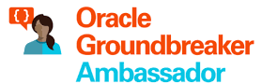



Lucas Jellema CTO for AMIS | Conclusion Cloud Solution Architect
lucas.jellema@amis.nl | technology.amis.nl | @lucasjellema | lucas-jellema

Slide 3
A traditional application
UI
API
WebApp
Platform & Language runtime features (transaction management, HTTP request handling, state management & in memory caching, IAM, …
3rd party libraries & frameworks
Monolith, Microservice, Module
Custom Code
Database (RDBMS?)
Java EE
JVM
Operating System
Hardware

Slide 4
Cloud Native Application
Cache
CDN & WAF
API Gateway
Function
SaaS
Event Hub
Web App
Function
Container Engine
Managed
Quick Provision & Decommission
Distributed
Automated
Pay per use/TCO
Vendor takes runtime responsibility
Enterprise grade platform accessible to startups
Rapid Innovation
Security & Availability
Scale
Vault
Mail
IAM
PaaS
Monitor
Alert & Notify
Scaling
Logging
IaaS
Notes:
Out of the box PaaS services and facilities
persistence, routing/throttling/buffer/queue/retry
IDM, key mgt, encryption/decryption
Distribution, CDN, regional failover
Monitor, log, alert/notification
Scalability (up & down)
Quick Rampup
Emphasis on interaction points: APIs, Events/ message format
Less emphasis on implementation of PaaS (platform) services
MongoDB API – implemented by Azure Cosmos DB, MongoDB, Minimongo and AWS Document DB and soon Oracle Autonomous JSON
Kafka API – Azure Event Hub, OCI Streaming, AWS Managed Streaming
JDBC/SQL – Relational Database (Oracle, SQL Server, PostgreSQL, MySQL) and even NoSQL (Oracle NoSQL, Cassandra, Hadoop)

Slide 5
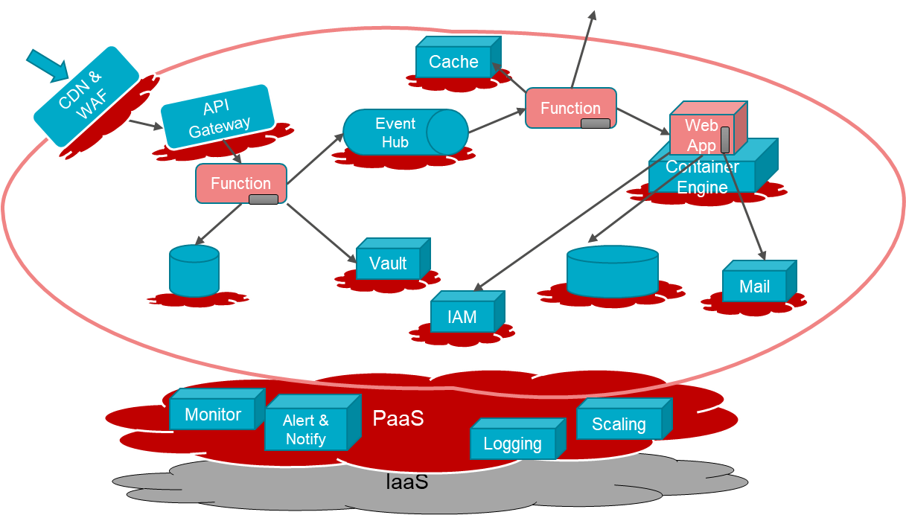
Characteristics of Cloud Native Applications
Modern – born in the cloud (era)
Emphasis on interaction (and decoupling) points:
Between custom components: APIs, Events / message format
From custom to PaaS Services: Service APIs, Formats and Protocols
Less emphasis on [and insulation from?] implementation of PaaS (platform) services
Key are industry standard APIs that are implemented by many different services
Custom code in small, simple units
No explicit Infrastructure (serverless, software defined) & managed Platform components
Stateless and Dynamically Scalable (Elastic) – expand and contract
Pay per Use
Automation – no hands on ACC and Production (speed, repeatability, dynamic adjustment)
Infrastructure/Platform as Code & Application CI/CD [pipelines]
Functions

Slide 6
What are Functions?
Stateless Execution Engines that handle one request or event
They can do anything regular applications can do – as long as they can do it in limited time (2-5 minutes max)
Serverless: functions are deployed and executed in an abstract, fully managed environment that automatically scales up and down (FaaS)
DevOps teams do not need | get to configure VMs, servers, network
Pay per execution – and per duration, memory and CPU
Glue and worker bees in cloud environments
For both application functionality and Ops-automation

Slide 7
Function Implementation
Implemented in any programming language – frequently JavaScript/Node, C#, Python, Go and Java; also shell, binary
Frequently backed (visible or implicitly) by Docker Containers
Parametrized via Configuration Settings
Leverage Cloud facilities
Logging
Monitoring
Authorization
IaaS: Compute, Network, Storage
Container Orchestration, Container Image Registry

Slide 8
Functions on Oracle Cloud Infrastructure run on Project Fn
Project Fn
Interacts with container platform – run | scale | watch | …
Is a generic open source framework that can run anywhere on Docker
Handles request – load balance, route, provide context
Manages application configuration settings
SDKs for main programming languages
Also works with generic Docker Container Images – e.g. GraalVM, shell
Command Line Interface
create, develop, deploy, invoke, inspect

Slide 9
Quick Demo of Oracle Functions
Create new Function (in existing App) locally
Implement special hello world
Deploy Function App locally
Invoke Function App locally
Through CLI
Change context to OCI
Deploy & Invoke
Show Invocation ‘evidence’
Container Image Registry
Metrics
Logging
(side effect?)

Slide 10
Mental picture vs Physical reality
Stateless? One execution per instance? Serverless?
Explore
Cross execution state (memory)
Multiple concurrent requests
Lifetime of an instance
Container details
Function with
Request counter (as cross execution state)
Concurrent requests counter (and multi second delay)
Write ‘still alive’ log messages
Get host details (from Fn context)

Slide 11






Mental Picture: Stateless and Serverless
FDK
Oracle Groundbreakers Tour 2020 EMEA | Make your Cloud Applications Function for real

Slide 12

Mental Picture: Stateless and Serverless “execution engine”
Configuration Parameters
FDK

Slide 13


Mental Picture: Build Process
Container Image Registry
FDK
push
FDK
Operating System
Language Runtime
go, java8, java9, java, java11, node, python, python3.6, python, python3.7, ruby, and kotlin
Notes:
Additional settings: max time to run (<= 120 seconds)
Note: size of local file system is related to memory shape (32, 64, 128, 256MB) as is the number of files

Slide 14
Mental Picture: Build & Deploy Process
Container Image Registry
Deploy Function Application
Associated with Network & Compartment
Specify max time to run and memory shape (128, 256, 512, 1024 MB) for function
FDK
push
Oracle Functions on OCI
FDK
Operating System
Language Runtime
Notes:
Additional settings: max time to run (<= 120 seconds)
Note: size of local file system is related to memory shape (32, 64, 128, 256MB) as is the number of files

Slide 15
Mental Picture and Actual Runtime
128 MB Memory, 32MB File System
File system can be read, /tmp can be written to
Configuration Parameters available as Environment Variables
Host name available in ctx parameter
Container Image Registry
Oracle Functions on OCI
Container Orchestrator
Serverless
Memory Shape, Max Time to Run, Configuration Parameters
VM
Server
Notes:
Additional settings: max time to run (<= 120 seconds)
Note: size of local file system is related to memory shape (32, 64, 128, 256MB) as is the number of files

Slide 16
Mental Picture and Actual Runtime
Container is kept running for 10-15 minutes – primed (hot) for handling more requests.
It is removed when it has been idle for that time.
It retains global state and file system contents during its lifetime. Note: hold on to and reuse expensive connections
Container Image Registry
Oracle Functions on OCI
Container Orchestrator
Stateless
VM
Server
Notes:
Additional settings: max time to run (<= 120 seconds)
Note: size of local file system is related to memory shape (32, 64, 128, 256MB) as is the number of files

Slide 17
Mental Picture and Actual Runtime
Container Image Registry
Oracle Functions on OCI
Container Orchestrator
VM
Server
Notes:
Additional settings: max time to run (<= 120 seconds)
Note: size of local file system is related to memory shape (32, 64, 128, 256MB) as is the number of files

Slide 18
Mental Picture and Actual Runtime
Container Image Registry
Oracle Functions on OCI
Container Orchestrator
VM
Server
Notes:
Additional settings: max time to run (<= 120 seconds)
Note: size of local file system is related to memory shape (32, 64, 128, 256MB) as is the number of files

Slide 19
Mental Picture and Actual Runtime
Oracle Functions starts multiple Docker containers, up to the limit specified for your tenancy. The default limit is 30 GB of RAM reserved for function execution per availability domain
Container Image Registry
Container Orchestrator
VM B
Server 2
Oracle Functions on OCI
Container Orchestrator
VM A
Server 1
Notes:
Additional settings: max time to run (<= 120 seconds)
Note: size of local file system is related to memory shape (32, 64, 128, 256MB) as is the number of files

Slide 20
Mental picture vs Physical reality
Stateless? One execution per instance? Serverless?
Explore
Cross execution state (memory)
Multiple concurrent requests
Lifetime of an instance
Container details
Function with
Request counter (as cross execution state)
Concurrent requests counter (and multi second delay)
Write ‘still alive’ log messages
Get host details (from Fn context)
requestCounter
concurrentRequests
lifetimeOfInstance
console.log()
process.on(‘exit’,…)
Notes:
https://stackoverflow.com/questions/14031763/doing-a-cleanup-action-just-before-node-js-exits
function sleep(ms) { return new Promise(resolve => setTimeout(resolve, ms)); }
async function delayedGreeting() { console.log("Hello");
await sleep(2000); console.log("World!");
}

Slide 21
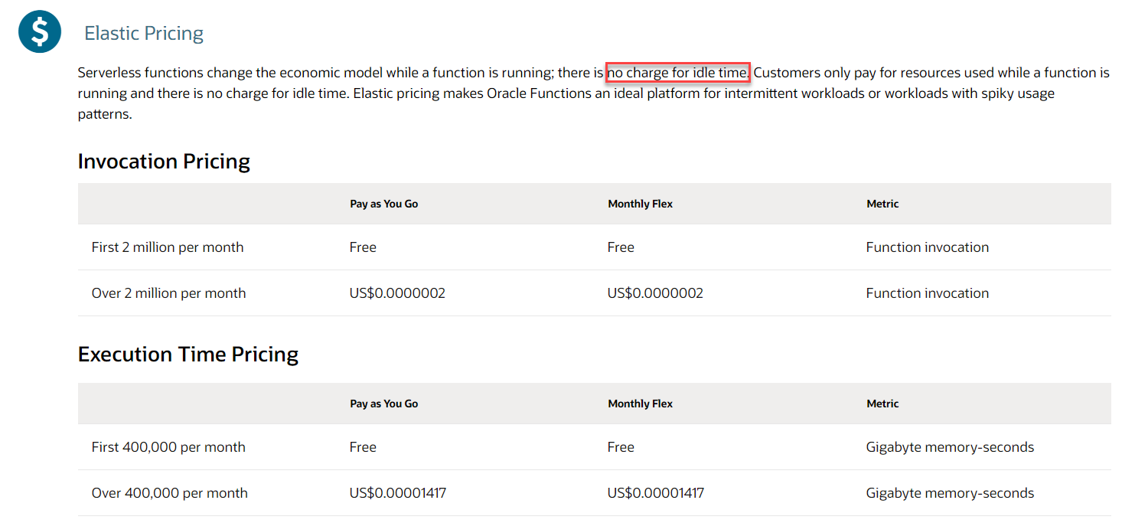
Pricing Oracle Functions – no use, no pay (and even if quite a bit of use – then still no pay)

Slide 22
Required on OCI to do Functions
Tenancy
Compartment
Network Group
Policies
Costs:

Slide 23
Leverage OCI PaaS Services and Facilities from Functions
Read from | Write to
Object Storage
Streaming
Vault (Keys, Secrets)
NoSQL Database
Autonomous Database
Retain state across executions
Requires Resource Principal authorization
Logging

Slide 24
Function execution is triggered by
HTTP Request
API Gateway
Cloud Event
Notification Topic (with retry!)
Monitoring Alert
Service Connector (currently only logging as source)
Terraform (Resource Manager) apply plan
Time Schedule
Not OOTB; use health check or OKE Cron Job

Slide 25
Extended Demo/Example

Slide 26






Demonstration of Cloud Native Application on OCI: Tweets to NoSQL, Streaming & Email
Function
Object Storage
Function
Events
Notifications
NoSQL Database
API Gateway
Healthcheck
Streaming
#groundbreakerstour

Slide 27


Tweets to NoSQL, Streaming & Email
Store JSON file with all tweets in time period
Cloud Event for new JSON file
Create Tweet Records in NoSQL
Trigger function with event
NoSQL Database
Invoke Tweet Aggregator every X minutes
Function
Publish to Notification Topic
Expose function to external callers
Object Storage
Write JSON document with Tweets
API Gateway
Streaming
Healthcheck
Events
Publish each Tweet to Stream
Function
Retrieve X minutes worth of tweets
Notifications
Send Tweet Report as email
Get Twitter credentials in secure way from vault
Vault
Logging
OCIR
Monitoring
Compartments
#groundbreakerstour
API/Service

Slide 28

Decoupling
Encapsulation (of implementation)
Run time availability independence
Independent release / reconfigure
Independence of scaling
Volume Load Throttling/Absorption
Security Boundary
Failure isolation
NoSQL Database
Function
Object Storage
API Gateway
Streaming
Events
Function
Notification Topic
Vault
Logging
OCIR
Monitoring
Compartments
#groundbreakerstour
API/Service

Slide 29

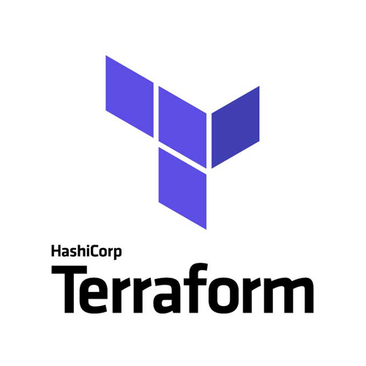
Platform Preparation – Infrastructure as Code using Resource Manager & Terraform plan
Function
Events
Notifications
Virtual Cloud Network with private and public subnet and access from and to public internet
Object Storage Bucket
API Gateway
NoSQL Database Table for persisting records
Healthcheck
Object Storage
Stream for publishing messages to
Skeleton API Gateway for deploying API routing rules to
Route Table
API Gateway
Internet Gateway
Security Lists
Dynamic Groups for API Gateway and for Functions
Virtual Cloud
Network
Streaming
Configuration of Logging Service for Functions
Groups
Compartment for Application resources
Secure Vault with Keys for Twitter credentials
Vault
Logging
Resource
Manager
Compartments

Slide 30
Serverless Function & Object Storage
Function
Events
Notifications
Store JSON file with all tweets in time period
API Gateway
Healthcheck
Object Storage
Write JSON document with Tweets
Retrieve X minutes worth of tweets
Function
Tweet Summarizer
Function
Central Logging Service
Get Twitter credentials in secure way from vault
Container Image Registry
Vault
Logging
OCIR
#groundbreakerstour

Slide 31
Test Functions

Slide 32
CI/CD – build, package, release, deploy
..
Fn CLI on build server
E.g. Jenkins
Visual Builder Studio (fka Oracle Cloud Developer Service)
Terraform
Deploy App plus Function (from existing Docker Container Image)
Execute Function

Slide 33
Other Function Ops
Monitoring
Logging
Application Configuration Settings

Slide 34
Get going with Functions on OCI
Resources
Katacoda
Docs
Tutorials
Sources/Samples

Slide 35
Overview Serverless Oracle Functions on OCI
Develop
Project Fn , programming language SDK support, custom Docker container
Configuration, Resource Principal, Interaction with OCI Services (e.g. persistence)
Test
Build & Deploy
Build container image, push image to registry, create function based on image
Required policies, Infrastructure as Code (Terraform, Pipeline); support in VB Studio (not Wercker)
Invoke
API Gateway
Cloud Event
Notification Topics
Operate
Health Check, Monitor, Log
Resources – docs, samples, Katacoda
Notes:
Function resources
https://github.com/oracle/oracle-functions-samples
https://docs.cloud.oracle.com/en-us/iaas/Content/Functions/Concepts/functionsoverview.htm
https://www.oracle.com/cloud/architecture-center.html
https://katacoda.com/redexpertalliance/courses/oci-course
https://fnproject.io/
https://docs.oracle.com/en/cloud/paas/visual-builder/visualbuilder-manage-development-process/build.html#GUID-7FEFC2B0-9868-47BE-A43C-6F58E37FECF8

Slide 36
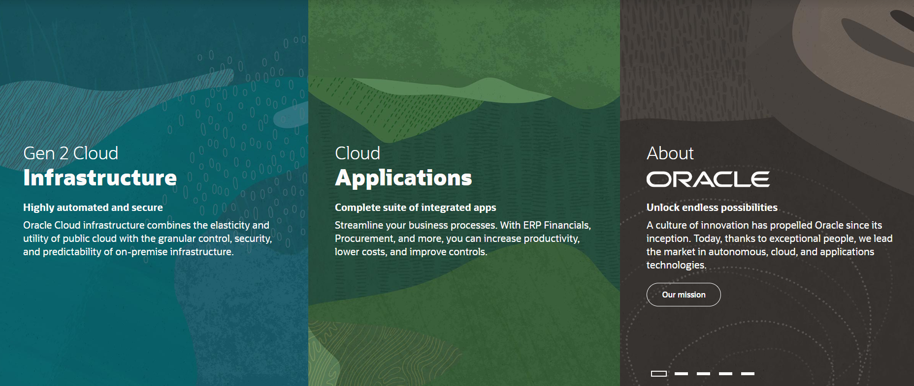
Introducing Oracle Cloud Infrastructure
IaaS & PaaS

Slide 37

Oracle Cloud Infrastructure
Generation 2 Cloud
Main themes:
Competitive Pricing
Secure by Design
Open
Enterprise (Technology)
Trials – 30 days, $300 credits
An always-free tier
With Autonomous Database and Autonomous Data Warehouse

Slide 38
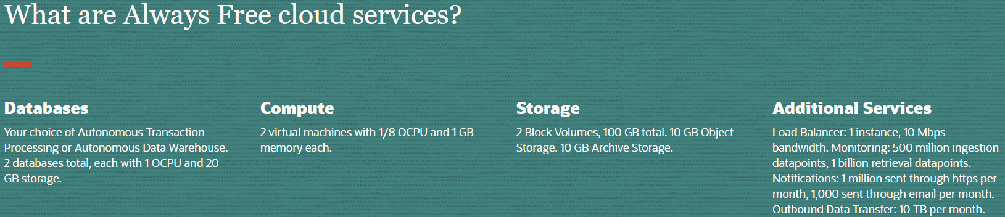
Oracle Cloud Infrastructure – Always Free Tier
Always Free Tier
Autonomous Database/Data Warehouse (two instances)
Compute VMs (two instances)
Block, Object and Archive Storage
Load Balancer and Data Egress
Monitoring and Notifications

Slide 39


OCI Services for Cloud Native Application Development
Health Check
Monitoring
Logging
Alarms
Notifi-cations
API Gateway
Functions
Streaming
Digital Assistant
NoSQL Database
Object Storage
Visual Builder
OKE – Managed Kubernetes
Container
Container
OCIR
ID & Access
Management
Tagging
Compartments
API/Service
Events
Resource
Manager
Search
Compute

Slide 40
Health Check
Monitoring
Logging
Alarms
Notifi-cations
API Gateway
Functions
Streaming
Digital Assistant
NoSQL Database
Visual Builder
Object Storage
OKE – Managed Kubernetes
Container
Container
OCIR
ID & Access
Management
Tagging
Compartments
API/Service
Events
Resource
Manager
Search
Vault
Compute

Slide 41
Health Check
Monitoring
Logging
Alarms
Notifi-cations
API Gateway
Functions
Streaming
Digital Assistant
OKE – Managed Kubernetes
Container
Container
NoSQL Database
OCIR
Visual Builder
Object Storage
Compute
ID & Access
Management
Tagging
Compartments
Vault
API/Service
Events
Resource
Manager
Search

Slide 42
Health Check
Monitoring
Logging
Alarms
Notifi-cations
API Gateway
Functions
Streaming
Digital Assistant
OKE – Managed Kubernetes
Container
Container
NoSQL Database
OCIR
Visual Builder
Object Storage
Compute
Events
ID & Access
Management
Tagging
Compartments
Vault
API/Service
Search
Resource
Manager

Slide 43





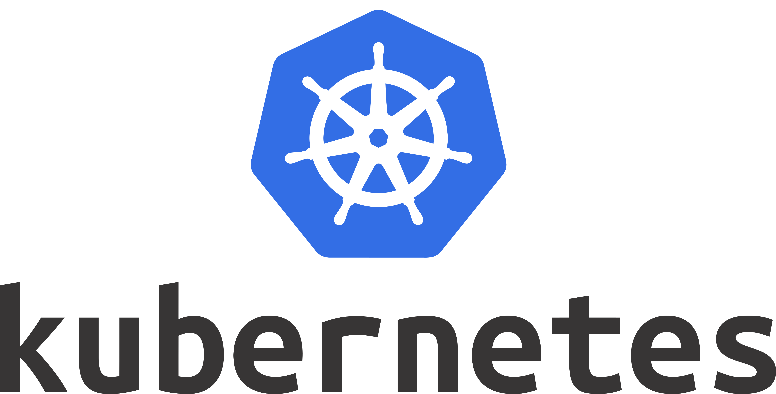

Health Check
Monitoring
Logging
Alarms
Notifi-cations
Healthcheck
Logging
API Gateway
Functions
Notifications
Telemetry/ Monitoring
Alarming
Streaming
Digital Assistant
OKE – Managed Kubernetes
Container
Streaming
Container
NoSQL Database
Container
OCIR
Visual Builder
Container
Object Storage
Compute
Object Storage
Virtual Machine
Events
ID & Access
Management
Tagging
Compartments
Vault
API/Service
Search
Resource
Manager

Slide 44
Tools
OCI Console – browser based GUI
OCI CLI
OCI SDKs – Java, Python, Ruby, Go, TypeScript
OCI REST APIs
Tools & Plugins
Ansible Modules
Terraform Provider
Chef Knife Plugin
Oracle Developer Tools for Visual Studio Code
Toolkit for Eclipse
HDFS Connector
OCI Cloud Tenancy

Slide 45
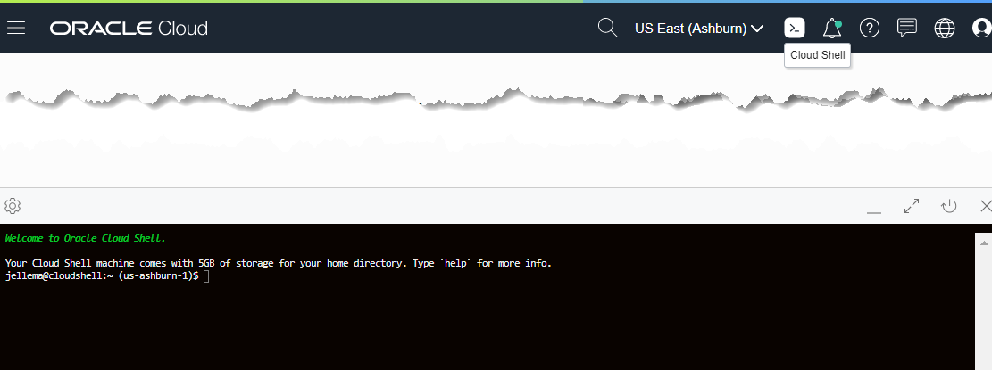

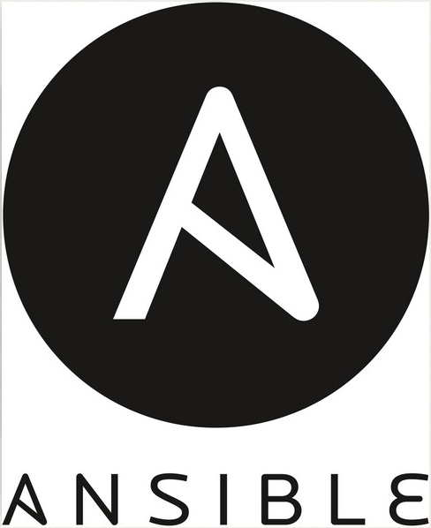



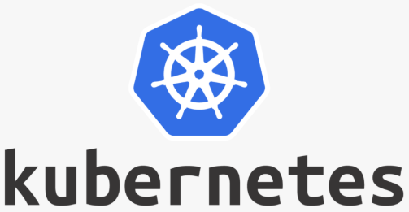







Cloud Shell
OCI Cloud Tenancy

Slide 46


Introducing Serverless Functions
The Container Native Serverless Framwork
Project Fn is an open source FaaS platform that you can run anywhere -- any cloud or on-premise.
It implements serverless Functions through Docker containers
Out of the box support for many runtimes
also support for custom Docker Container (white box)
Project Fn is the foundation for Serverless Functions on OCI

Slide 47
Fn Functions – request handling
With method, headers, query parameters, url path, body
Function as a Service framework
FDK
HTTP Request
Function Implementation (Node, Java, Go, Python, custom Docker, …)
input – derived from body
ctx – raw HTTP request components

Slide 48
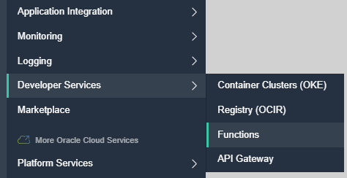
Oracle Functions
Functions on OCI – based on Fn
Function Container Images are stored in OCI Container Registry
Triggers can be:
HTTP Requests
OCI Events
API Gateway calls
OCI gathers logs and metrics
A function instance (i.e. a container) will be removed after 5-10 minutes of inactivity
Note: an instance can handle multiple requests

Slide 49
Oracle Cloud Infrastructure
invoke
invoke
Application
Function
OCIR
Project Fn
Container Image for Function
oci fn function invoke …
oci raw-request …
deploy
OCI Config
Docker Container with Function & Runtime
Test & Production Environmentd
OCI CLI
Code
Development Environment

Slide 50
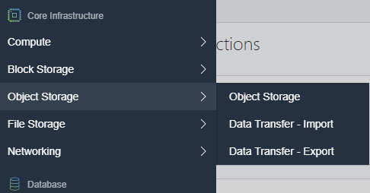
Object Storage
“an internet-scale, high-performance storage platform that offers reliable and cost-efficient data durability. The Object Storage service can store an unlimited amount of unstructured data of any content type, including analytic data and rich content, like images and videos.”
Note: use Archive Storage for data which you rarely access, but that must be retained and preserved for long periods of time.
The cost efficiency of the Archive Storage tier offsets the longer lead time required to access the data.

Slide 51
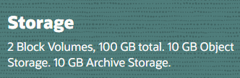
Object Storage
A regional service – not tied to a compute instance or even an AD
Organized in Namespaces, Buckets (similar to Folders) and Objects
Max Object Size is 10TiB (in parts of max 50 GiB)
one tebibyte (1 TiB) is approximately equal to 1.1 TB
Object Storage is Always Free eligible
Object Storage provides
Durability – multiple copies, automatically maintained
Encryption - 256-bit Advanced Encryption Standard (AES-256)
S3 Compatible REST API
HDFS Connector (to act as backend for Spark and Hadoop MapReduce)
Pre-authorized requests for time-limited, direct access
Life Cycle Rules

Slide 52
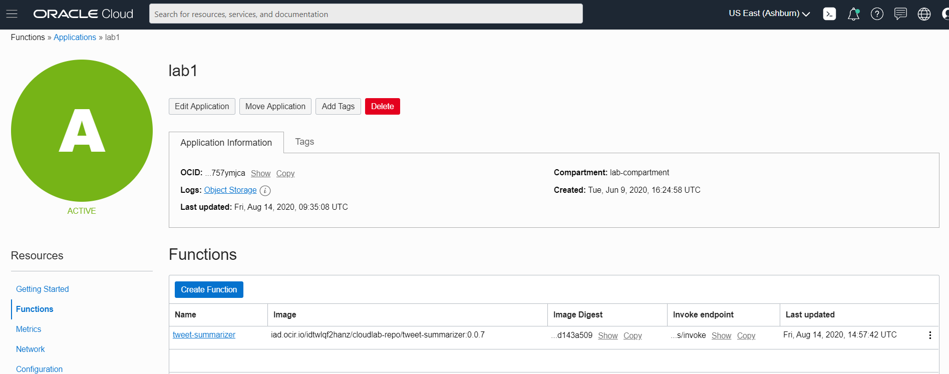
Function tweet-summarizer in application lab1

Slide 53
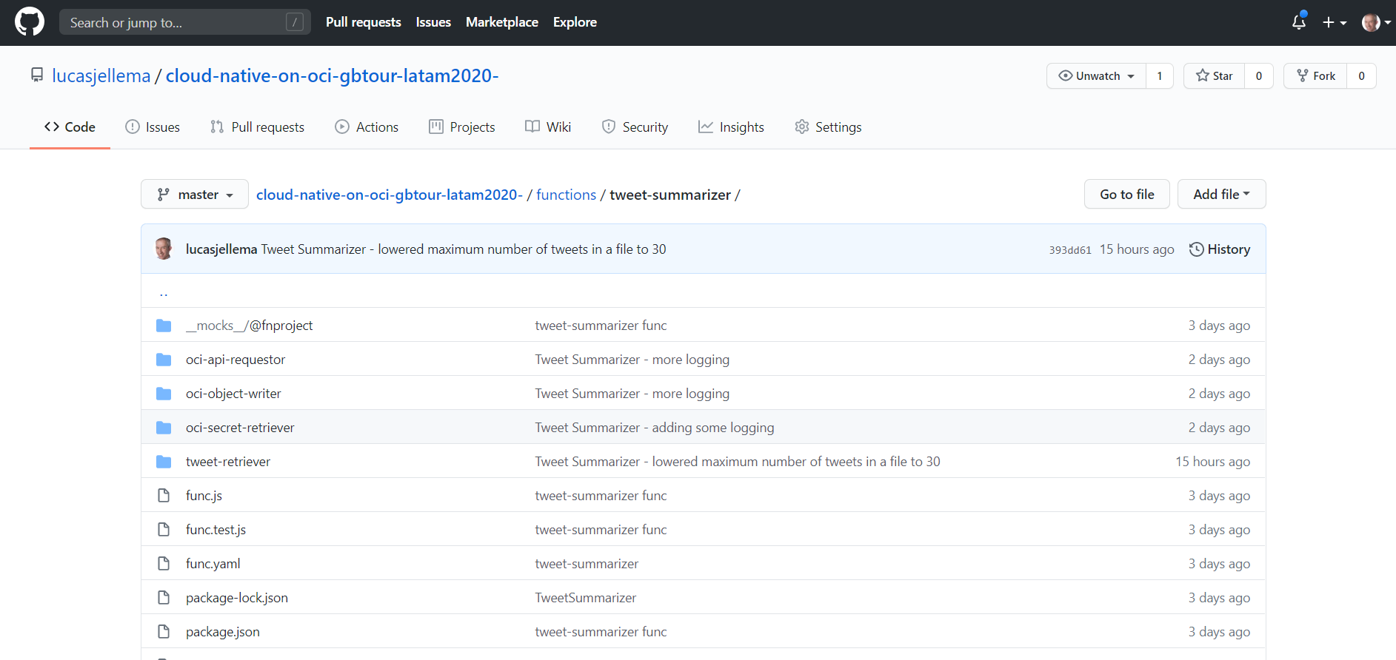
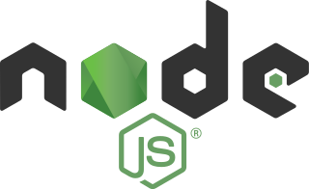
Function tweet-summarizer – source code in GitHub
Sources: bit.ly/cloud-native-latam2020

Slide 54
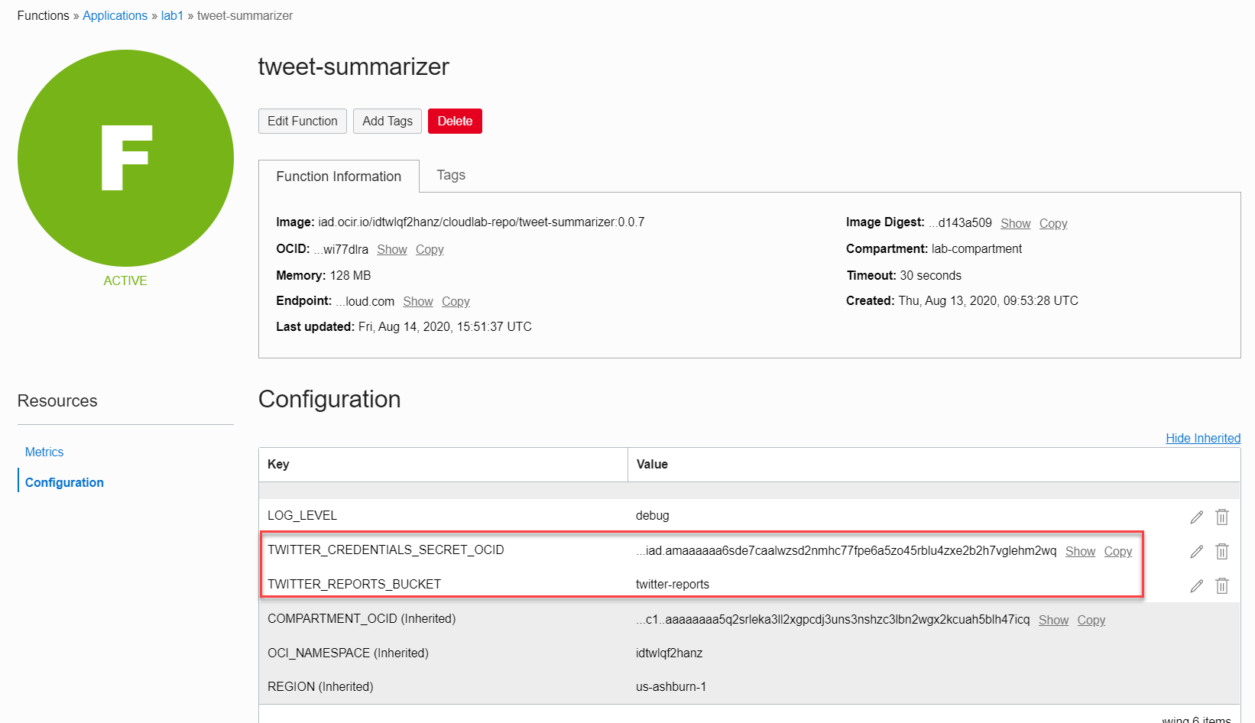
Configuration Settings for Function tweet-summarizer result in environment variables accessible within the function
Vault

Slide 55
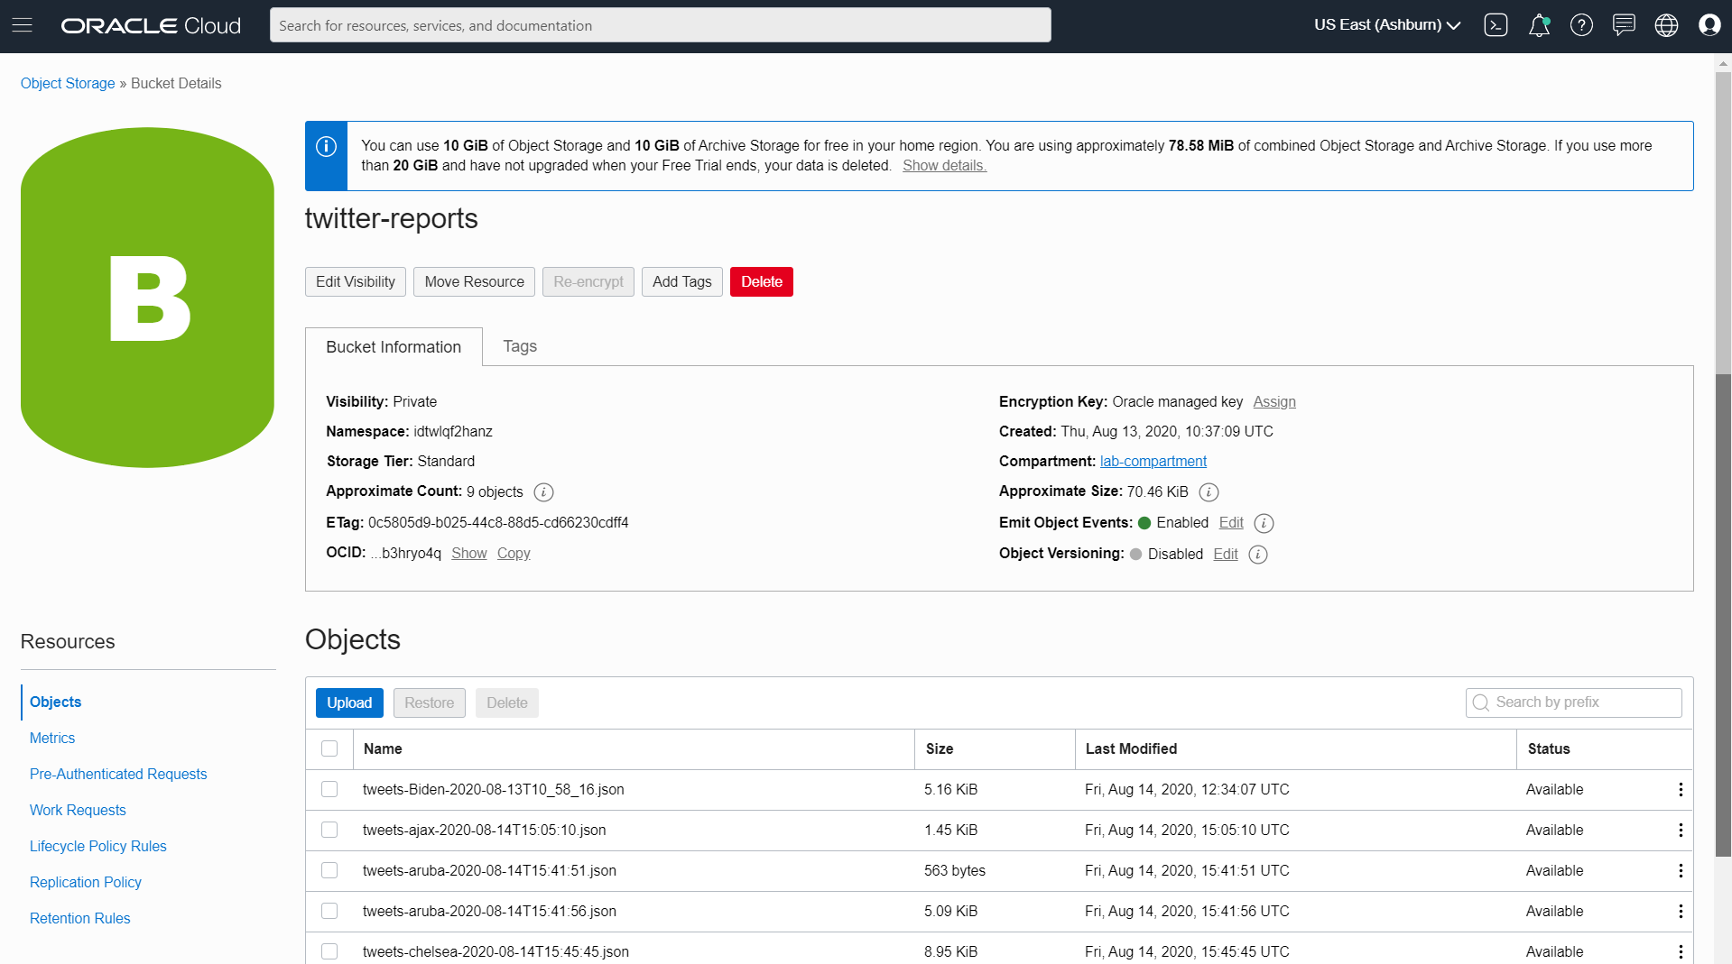
Object Storage – Bucket for twitter reports

Slide 56
Serverless Function & Object Storage
Function
Events
Notifications
Store JSON file with all tweets in time period
API Gateway
Healthcheck
Object Storage
Write JSON document with Tweets
Retrieve X minutes worth of tweets
Function
Tweet Summarizer
Get Twitter credentials in secure way from vault
Vault
Logging
OCIR
#groundbreakerstour

Slide 57
Public and Managed Access to Function Tweet Summarizer
Function
Events
Notifications
Healthcheck
Expose function to external callers
Object Storage
API Gateway
Function
Tweet Summarizer
Function
Vault
Logging
OCIR
#groundbreakerstour

Slide 58
API Gateway
Expose private endpoints publicly
Stable (public) endpoints
Routing (verb & wildcard based)
Parameter and Header mapping
Request Policies
Rate limiting (per client & general)
CORS (for direct web client access)
Metrics Monitoring & Logging
Authentication & Validation
Handle HTTP calls:
Authorize
Route
Map
Monitor/ Audit
GA was Mid December 2019
Function
Any Service Invoker
API Gateway
Stock
Any 3rd party HTTP endpoint
VM
Any HTTP Endpoint on OCI
OKE
OIC
…
Oracle Cloud Infrastructure

Slide 59
API Gateway Authorizer Function
Authorizer Function can be configured on Route or on API Deployment
Any backend – HTTP destination, Oracle Function, Stock Response – can be subject to an authorizer function
Invoke API, provide token in header
JSON returned by Authorizer Function is embedded in request to backend
Any Service Invoker
API deployment
/path
Any backend
API Gateway
Authorizer Function
Authorizer Function that allows or denies access based on Header [Token]
Oracle Cloud Infrastructure

Slide 60
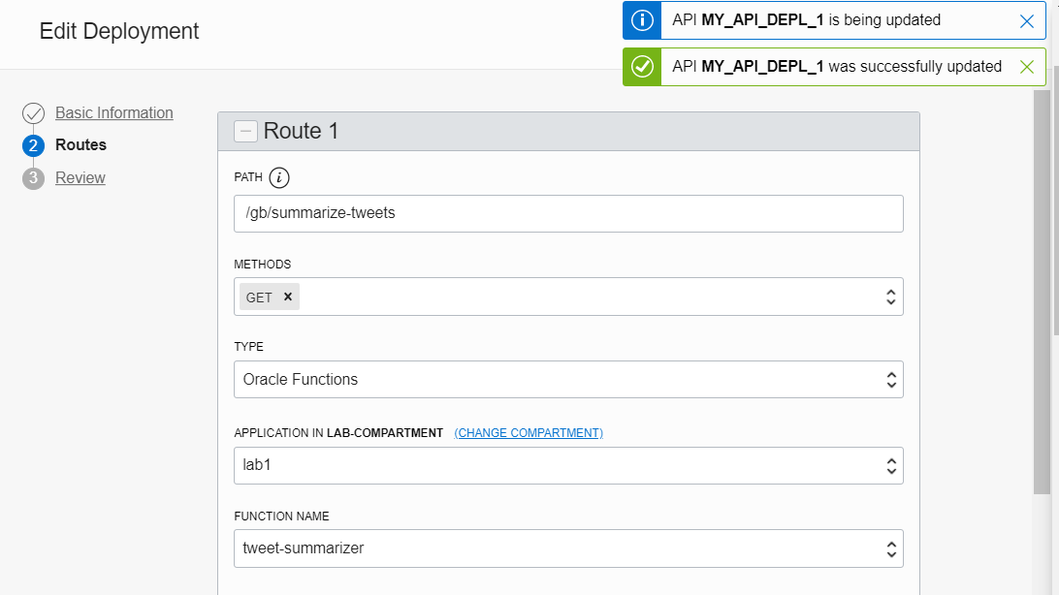
API Gateway Configuration for public access to Function

Slide 61
Public and Managed Access to Function Tweet Summarizer
Function
Events
Notifications
Healthcheck
Expose function to external callers
Object Storage
API Gateway
Function
Tweet Summarizer
Function
Vault
#groundbreakerstour

Slide 62
Produce CloudEvent, Publish Notification & Send Mail
Function
Cloud Event for new JSON file on Object Storage
Publish to Notification Topic
Healthcheck
Object Storage
API Gateway
Events
Notifications
Function
Send Tweet Report as email
Vault
#groundbreakerstour

Slide 63
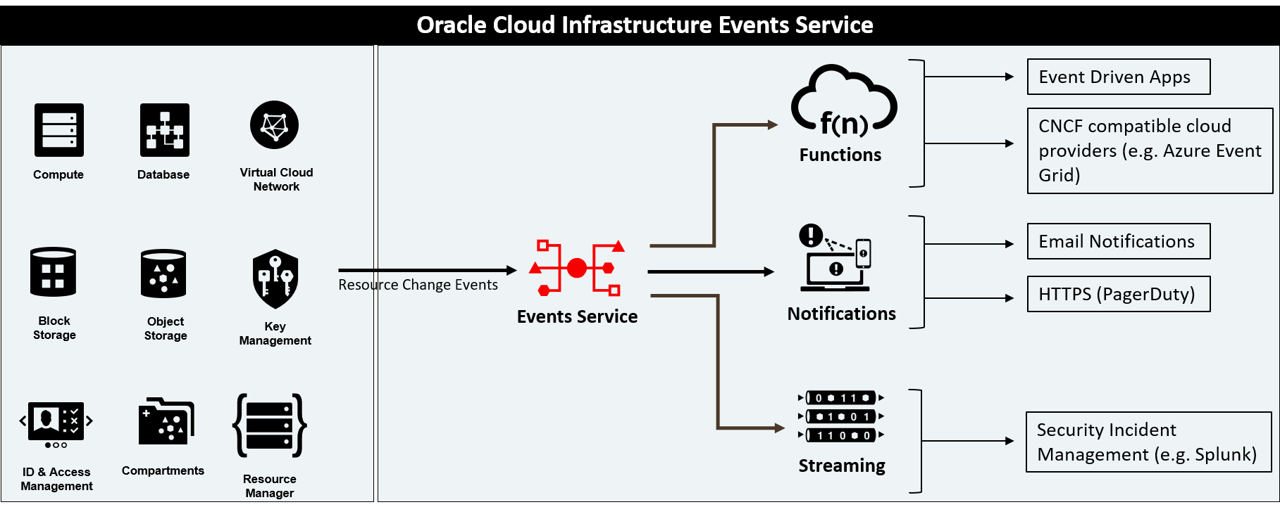
EVENTS and NOTIFICATIONS SERVICES

Slide 64
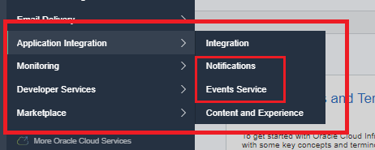
EVENTS and NOTIFICATIONS SERVICES
Events and Notifications are OCI Services that were released last year (2019), and that are used to configure rules, notifications and events that happen within the OCI infrastructure
For example: every time a user creates a Bucket within the Object Storage, you (as an operator) may be interested to get an email or run a function. Well that is exactly the purpose of this
The basics of this are:
Notifications
Subscriptions
Topics
Rules
Events

Slide 65
Events identified and turned to Notification Events to be Published and Routed
Event
OCI Resource
Cloud Event
Event
Email
Cloud Event
Notifications
Event
Event Rules
Notification
Topic
Functions
Subscriptions
Event
Streaming
Functions
Streaming

Slide 66
THE BASICS FOR THESE TWO SERVICES ARE…
EVENTS SERVICES
NOTIFICATION SERVICES
Event
OCI Resource
Cloud Event
Event
Email
Notifications
Event
Event Rules
Notification
Topic
Functions
Event
Streaming

Slide 67
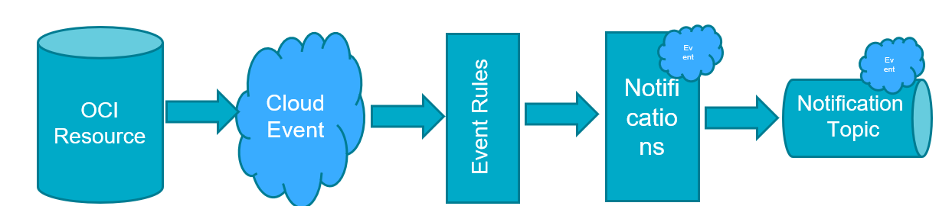
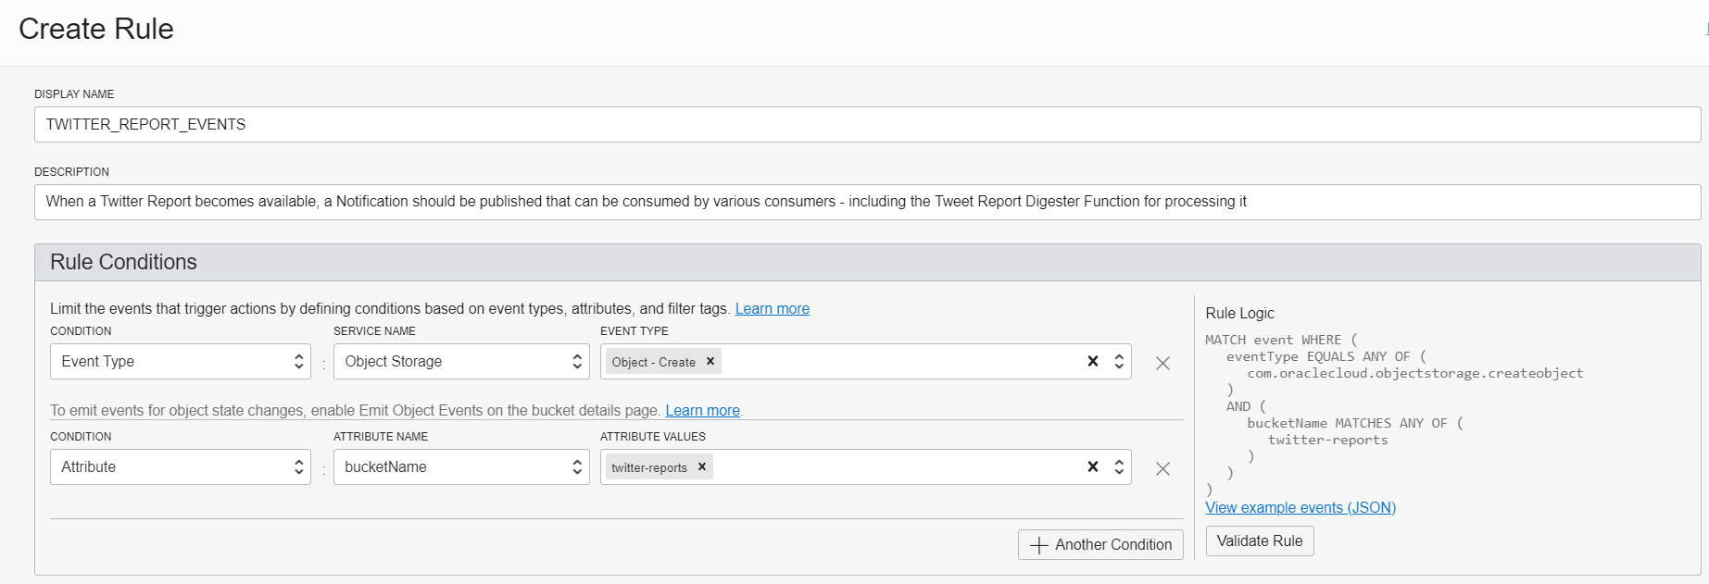
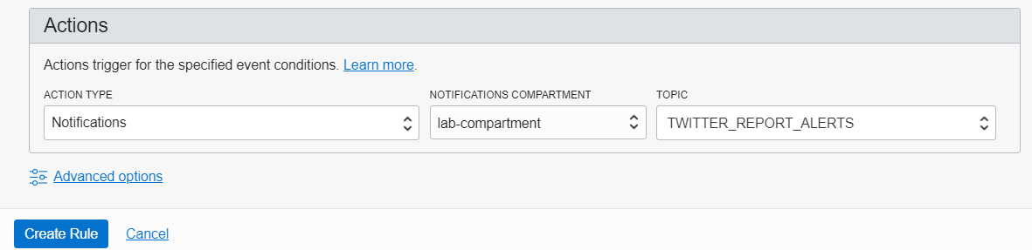
Configure Event Rule Notification triplet
Cloud Event
Event Rules
OCI Resource
Notifications
Notification
Topic

Slide 68
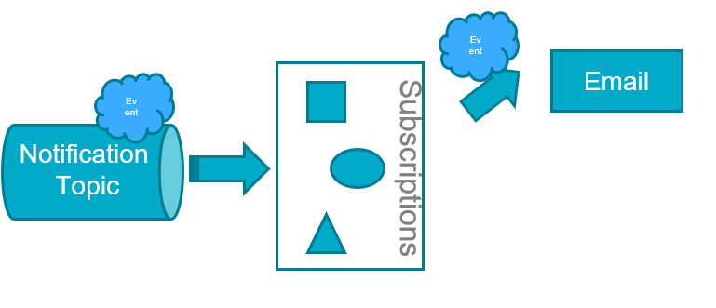
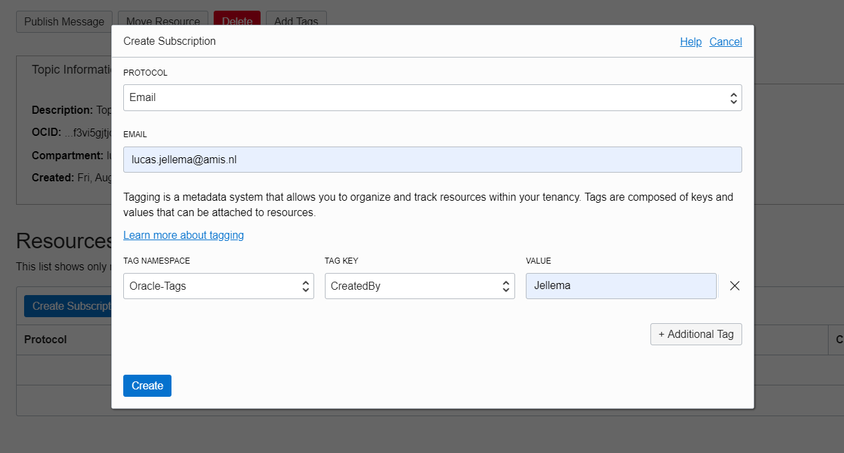
Send email upon Notification

Slide 69
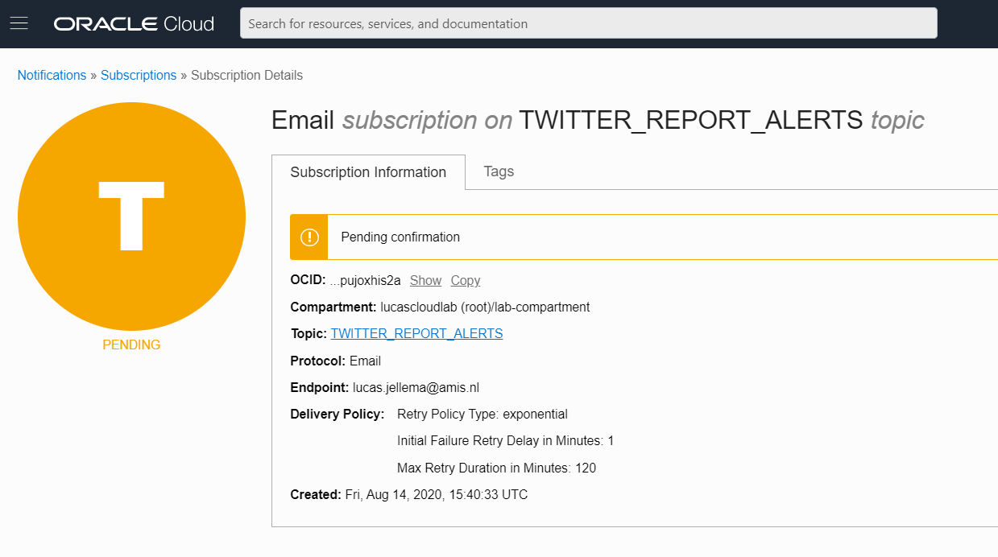
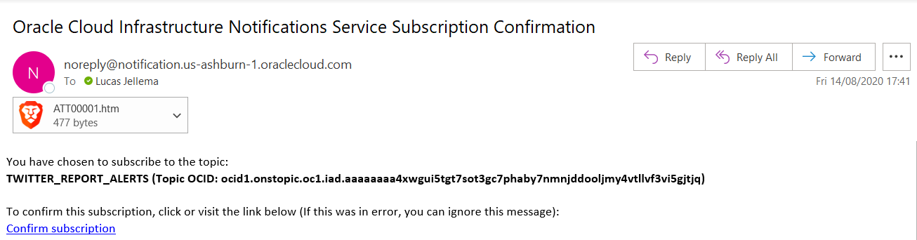
Email Subscription is Pending until confirmed

Slide 70
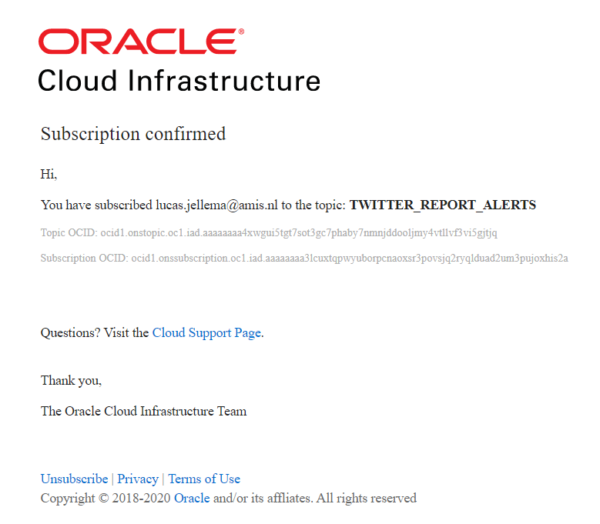
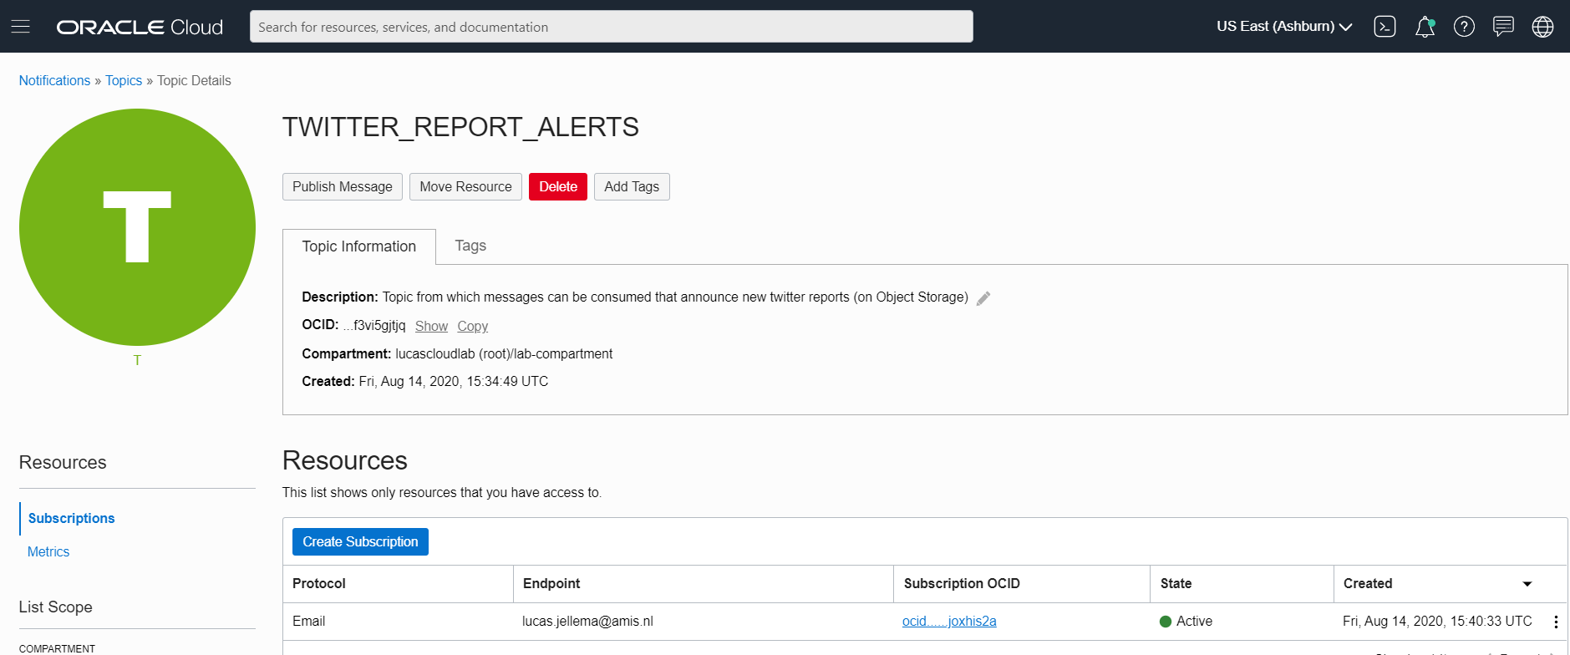
When confirmed, the subscription is active

Slide 71
When the Tweet Summarizer is invoked…
Object Storage
API Gateway
Events
Notifications
Function
Vault
Oracle Groundbreakers Tour 2020 LATAM | Oracle Cloud Native Application Development

Slide 72
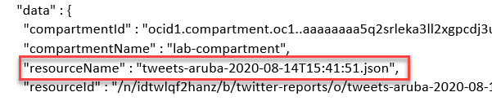
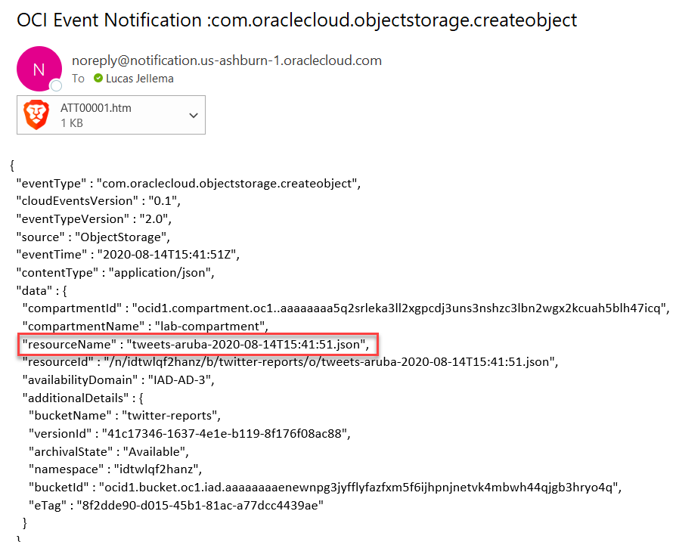
… the email informs of the new file
Object Storage
API Gateway
Events
Notifications
Function
Vault
Oracle Groundbreakers Tour 2020 LATAM | Oracle Cloud Native Application Development

Slide 73
Produce CloudEvent & Publish Notification
Function
Cloud Event for new JSON file
Publish to Notification Topic
Healthcheck
Object Storage
API Gateway
Events
Notifications
Function
Send Tweet Report as email
Vault
#groundbreakerstour

Slide 74
Trigger Function & Store NoSQL Records
Retrieve Tweet Report
Create Tweet Records in NoSQL
NoSQL Database
Function
Healthcheck
Object Storage
Trigger function with event
API Gateway
Events
Notifications
Function
Vault
#groundbreakerstour

Slide 75

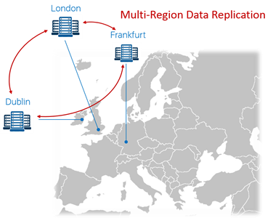
Introducing NoSQL Database Cloud Service
Launched in February 2020 – a fully managed cloud service
Based on Oracle NoSQL Database
Which itself is based on Berkeley DB as storage engine
Schemaless JSON and SQL enabled on relational data
ACID, consistent, relational, structured, joins
Partial JSON Updates
Server-side updates to JSON documents
Time-To-Live – auto-expire on records
Built-in Data Redundancy
Multi-region architecture
read-anywhere/write-anywhere in “WAN” cluster
REST APIs, OCI CLI and SDKs in Java, Python, Node and Go
NoSQL Database Cloud Simulator for local development and testing
Note: August 13th 2020 – announcement of “Autonomous JSON Database

Slide 76
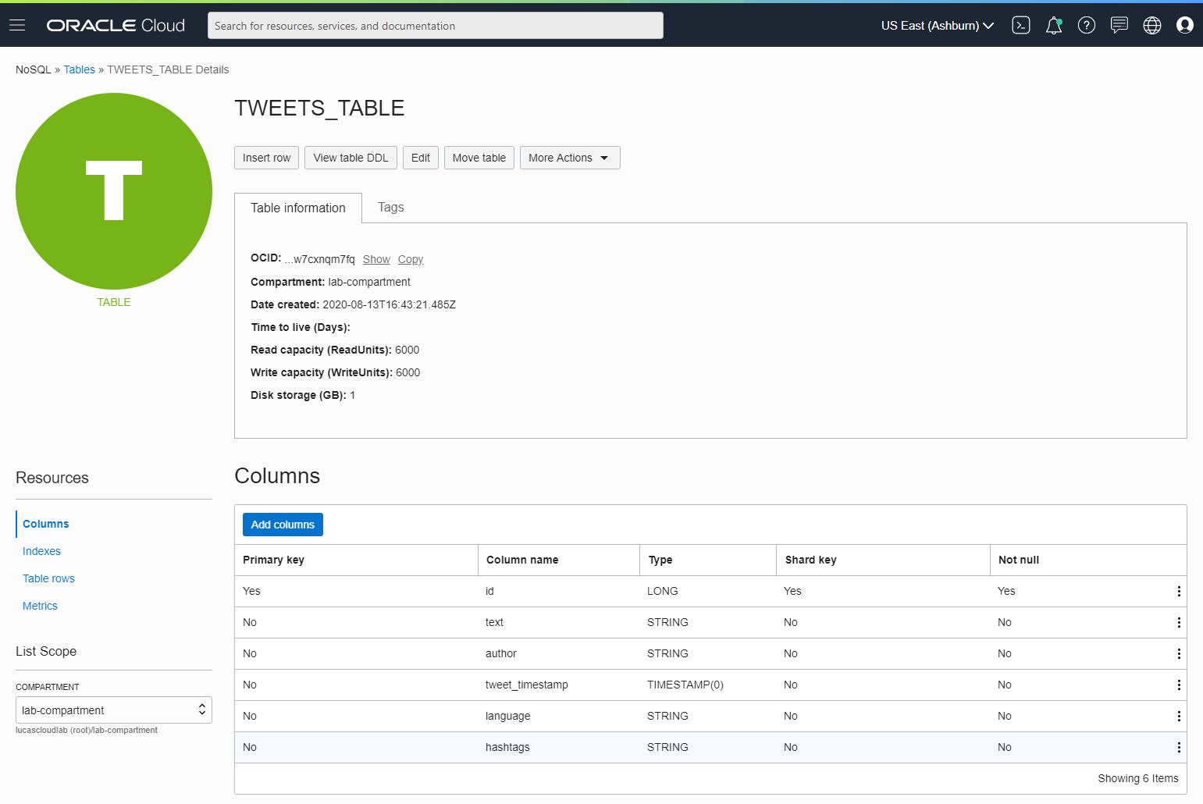
NoSQL Database Table TWEETS_TABLE

Slide 77
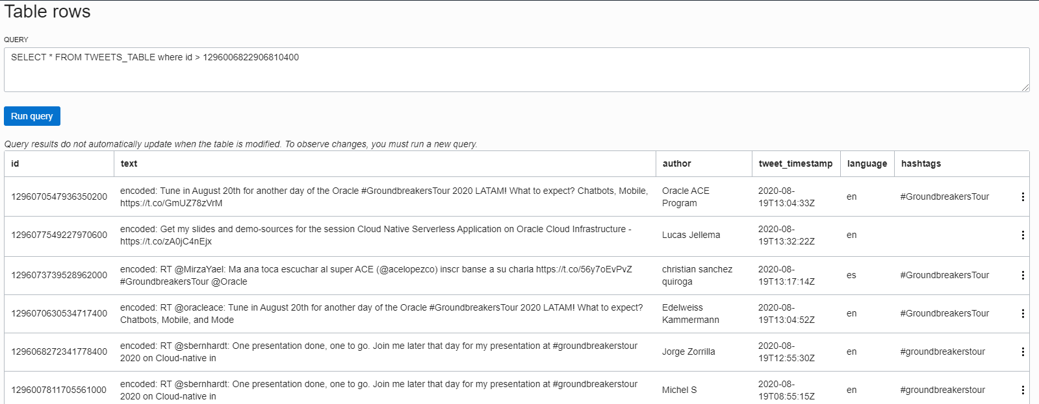
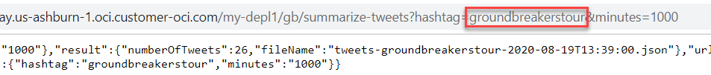
Tweet Records in TWEETS_TABLE

Slide 78
Trigger Function & Store NoSQL Records
Retrieve Tweet Report
Create Tweet Records in NoSQL
Trigger function with event
NoSQL Database
Function
Healthcheck
Object Storage
API Gateway
Events
Notifications
Function
Vault
#groundbreakerstour

Slide 79
Stream records
NoSQL Database
Function
Healthcheck
Object Storage
API Gateway
Events
Streaming
Notifications
Publish each Tweet to Stream
Function
Vault
#groundbreakerstour

Slide 80
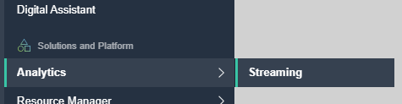
OCI Streaming Service
Kafka Like – Event Queue
Support for partitions and consumer groups
Events are Published and Consumed through REST API calls
Java SDK available
No Push to Consumer!
Consumer has to poll
Oracle Cloud Infrastructure
OCI Streaming
Stream
Listener
Publisher
Listener
Listener
On prem
3rd Party Cloud

Slide 81
OCI Streaming Service
Message retrieval is done through a “Cursor”
Similar to a (long running) query
Cursor indicates where to read from Stream
Earliest, latest, at offset, from offset, from time
No Filter to apply upon reading
Message Retention: 7 days
Max throughput: 1 MB/s
Max message size: 1 MB
Oracle Cloud Infrastructure
cursor
OCI Streaming
Stream
Listener
Publisher
Listener
Listener
On prem
3rd Party Cloud

Slide 82
(Cloud) Events can be published to Stream directly
Streaming

Slide 83
Stream records
NoSQL Database
Function
Healthcheck
Object Storage
API Gateway
Events
Streaming
Notifications
Publish each Tweet to Stream
Function
Vault
#groundbreakerstour

Slide 84
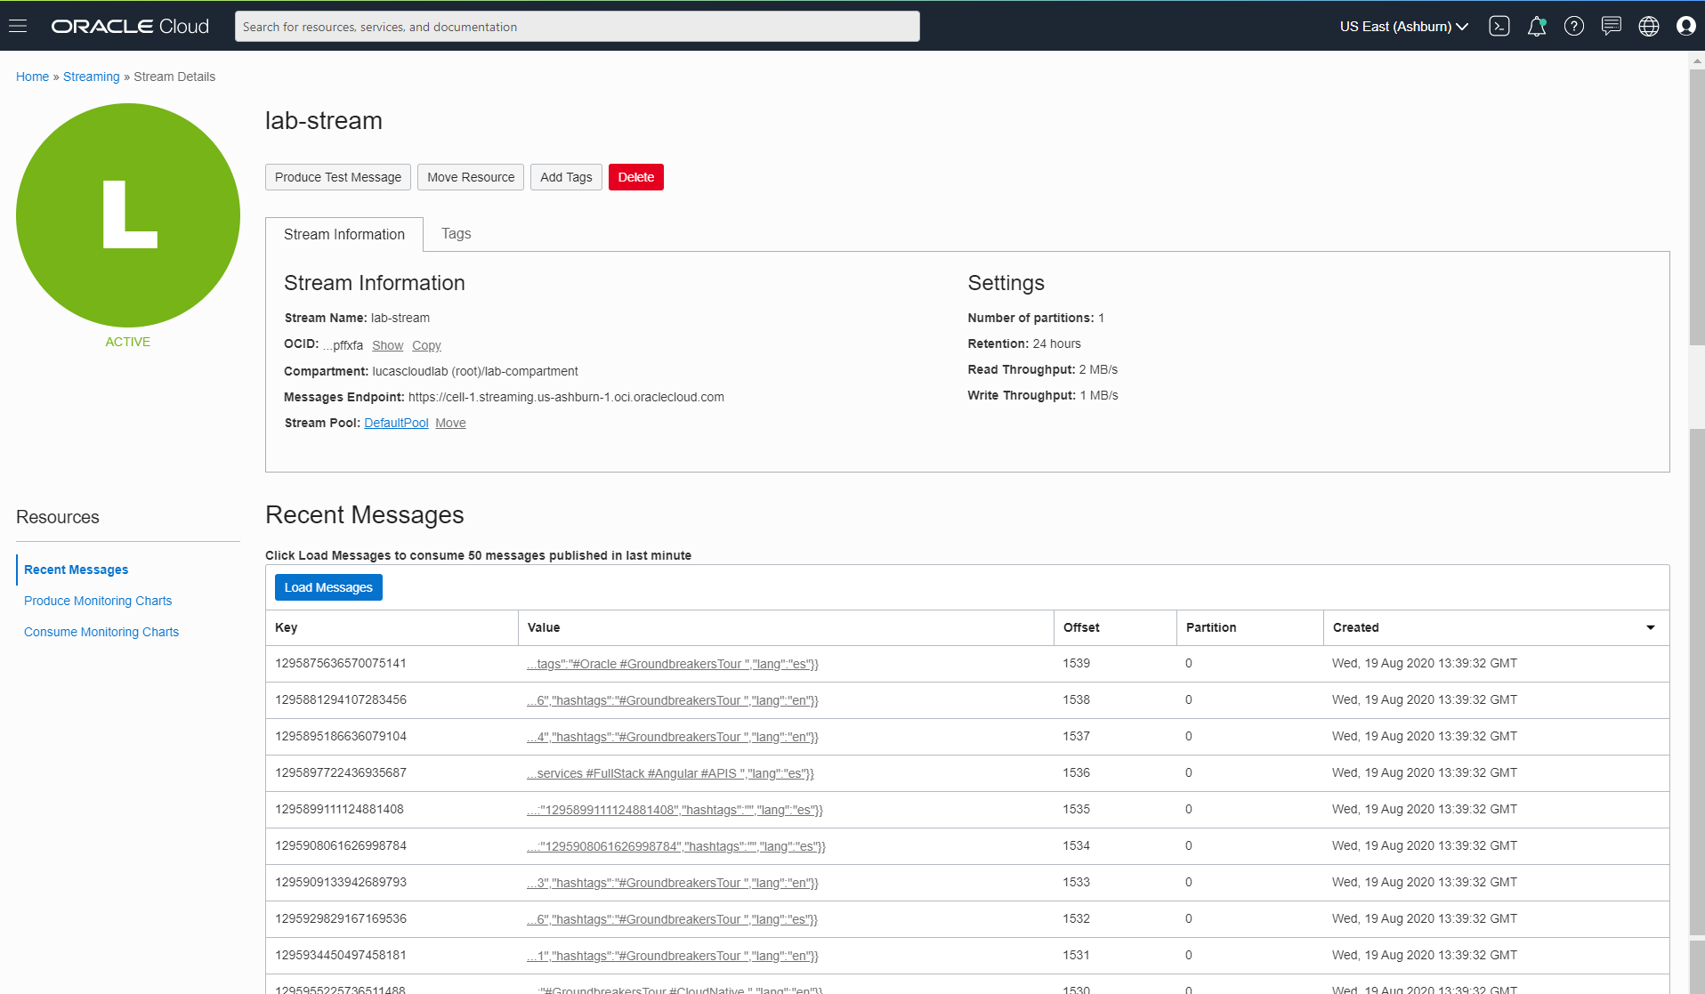
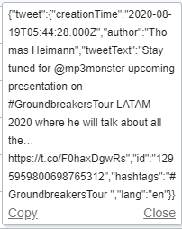
Tweet Messages Published by Function consumed from the Stream

Slide 85
Schedule Function for periodic execution
NoSQL Database
Function
Invoke Tweet Aggregator every X minutes
Object Storage
API Gateway
Events
Healthcheck
Streaming
Notifications
Function
Vault
#groundbreakerstour

Slide 86
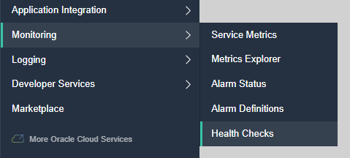
Monitoring | Health Checks
Verify through the eyes of an external client if endpoints are available and respond quick and well
Periodic or Adhoc call to an endpoint
HTTP(S) or Ping
Specify Headers
Specify Interval
From selected Vantage Points
3rd party clouds, geographic location
Health Check results can be inspected through the Monitor in the Console

Slide 87
Monitoring – Health Checks
OCI does not currently have a way to schedule jobs
Health Checks are scheduled HTTP(S) requests
Invoke Tweet Aggregator every X minutes
API Gateway
Healthcheck
Function

Slide 88
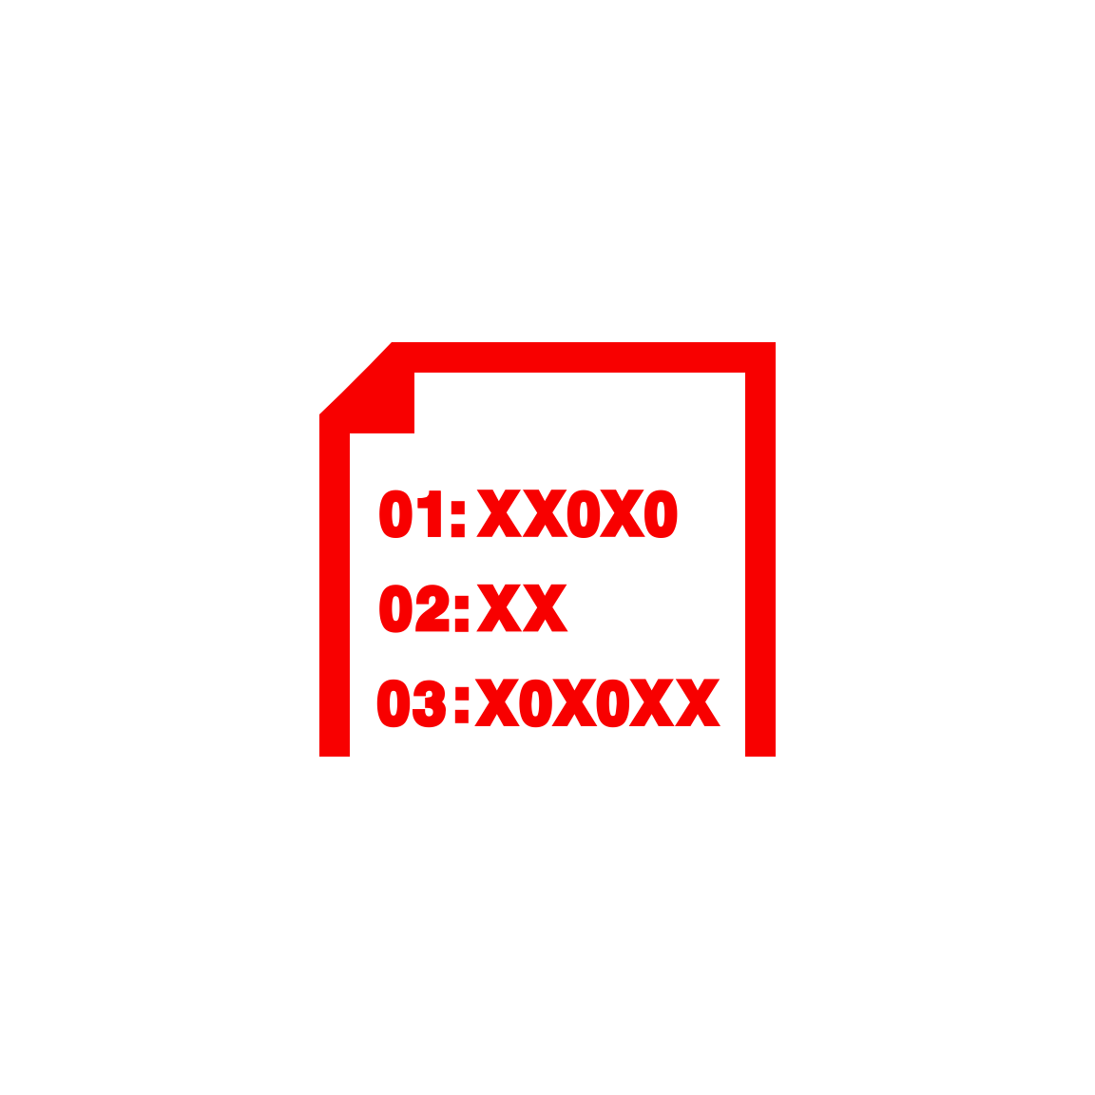
Summary
Cloud Native: Platform Services
Managed
Quick Provision & Decommission
Distributed
Automated
Pay per use/TCO
Vendor takes runtime responsibility
Enterprise grade platform for all Security & Availability
Scale
Ops facilities (monitor, log, failover)
Rapid Innovation (new services, new features, new pricing)
NoSQL Database
Function
Object Storage
API Gateway
Events
Streaming
Notifications
Function
Healthcheck
Email Delivery
Vault
OCIR
Logging
Telemetry/ Monitoring
Compartments
#groundbreakerstour

Slide 89
Oracle Functions - Points for improvement
Function to Function invocation could be much simpler
Simple Fn SDK call instead of complex OCI API call
Automatic tracing of function calls
Asynchronous mechanism for function triggering
OCI Streaming does not trigger function execution
OCI Notification Topics are capped at 60 messages per minute
OCI API Gateway only handles synchronous requests – not fire & forget
Function orchestration or coordination
Workflow, parallel execution, transaction handling (Saga pattern)
Project Fn is showing hardly any activity on GitHub
Is it alive? Does it have a future?

Slide 90
Thank you for your attention I hope this was useful
Sources and slides: bit.ly/..
lucas.jellema@amis.nl | technology.amis.nl | @lucasjellema | lucas-jellema

